Slide 1
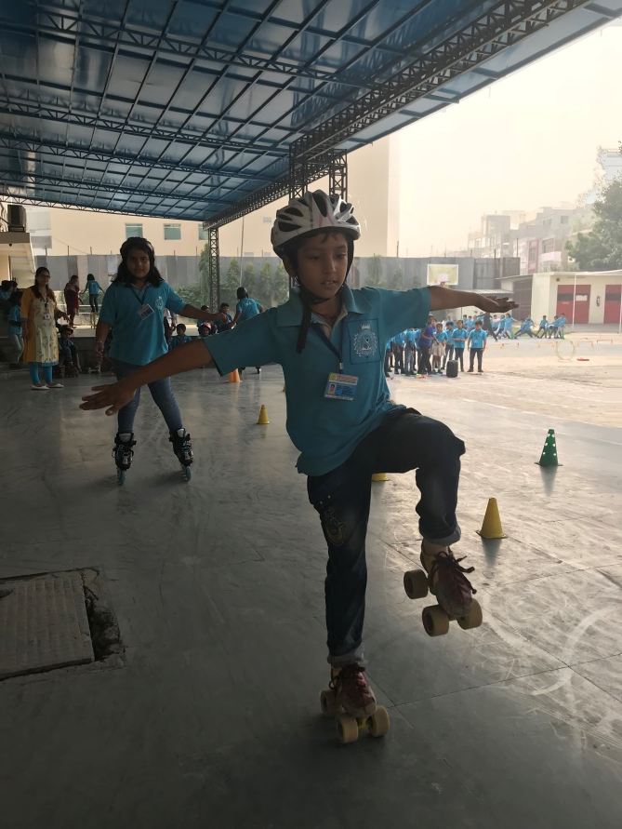
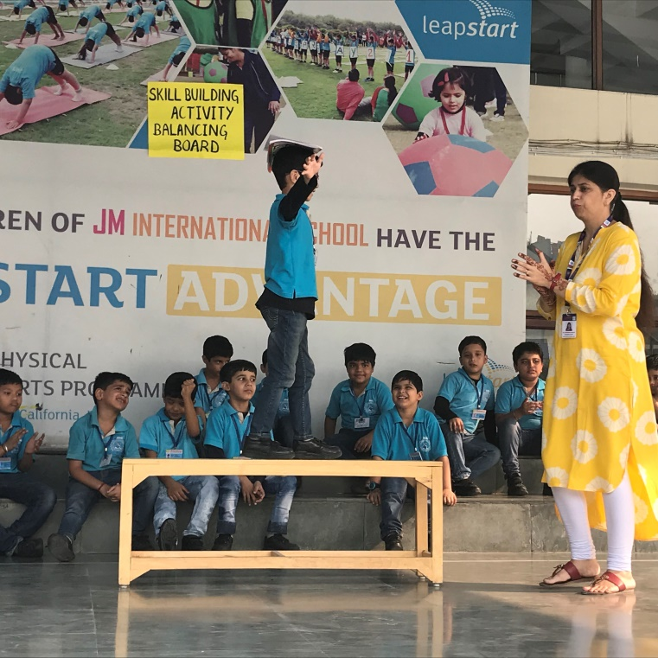
J M International School
Sector-6, Dwarka, New Delhi
J M International School, celebrates the Outdoor Classroom Day with full vigor and zeal. The teachers, the principal playing with the kids. Full excitement among the kids and teachers, as they celebrate the efforts of outdoor learning which they regularly do as part of their curriculum.
Can you do it?
Flying with joy. Kids getting lessons of life through sports.
Wow….
How easily the kids develop both physically and mentally when taken outdoors….

Slide 2
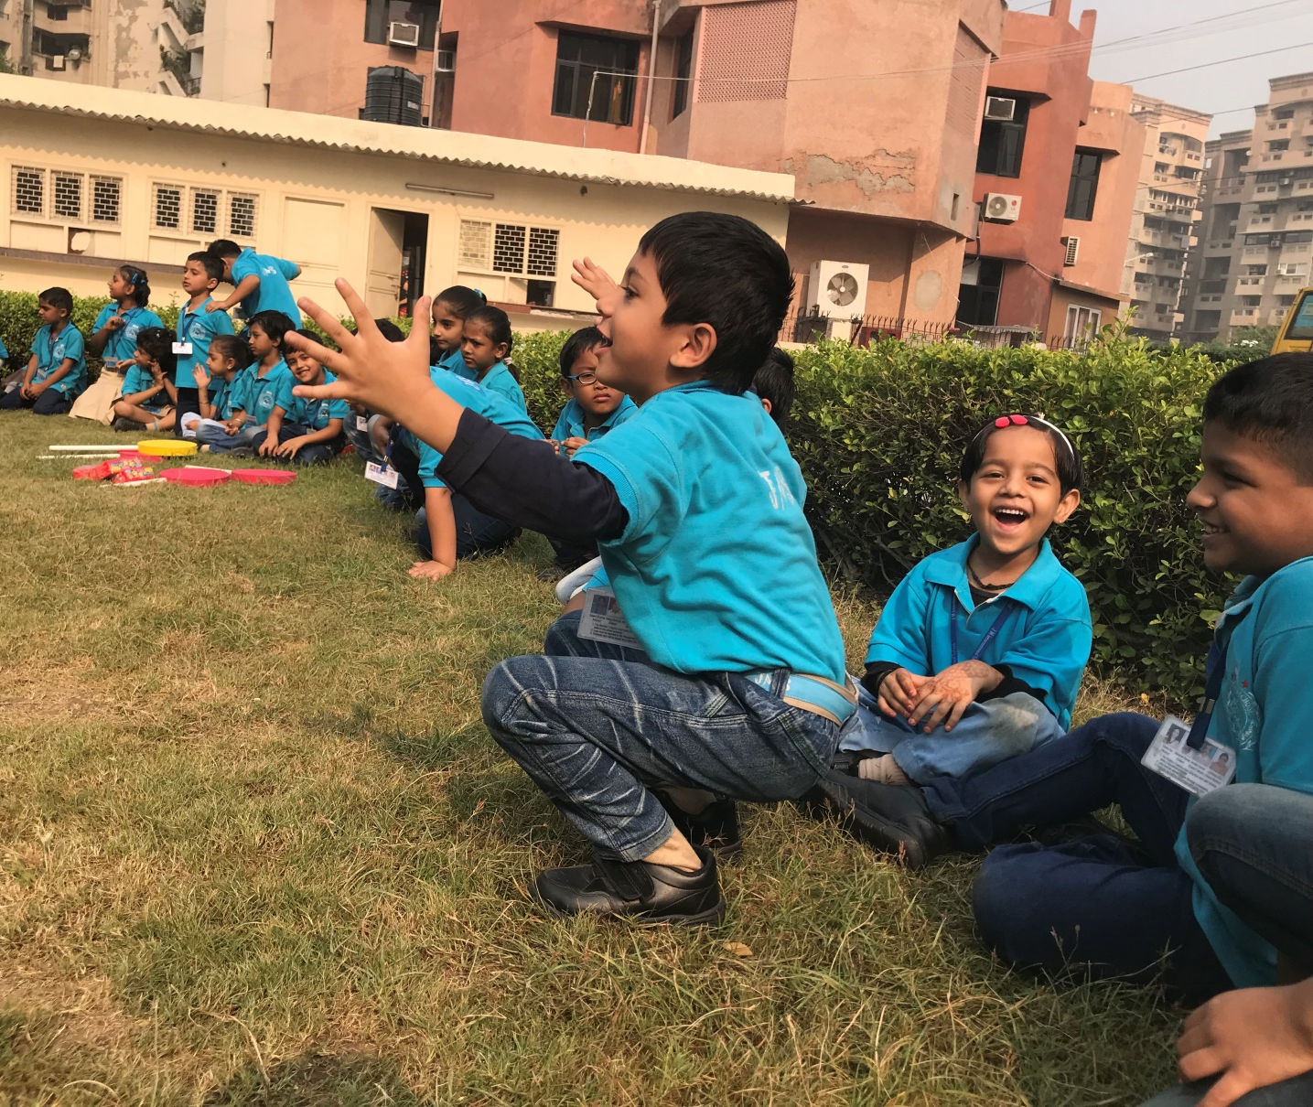
Complete ecstasy ……………even a vison of these happy faces give immense pleasure…….Nature and kids………!!!

Slide 3
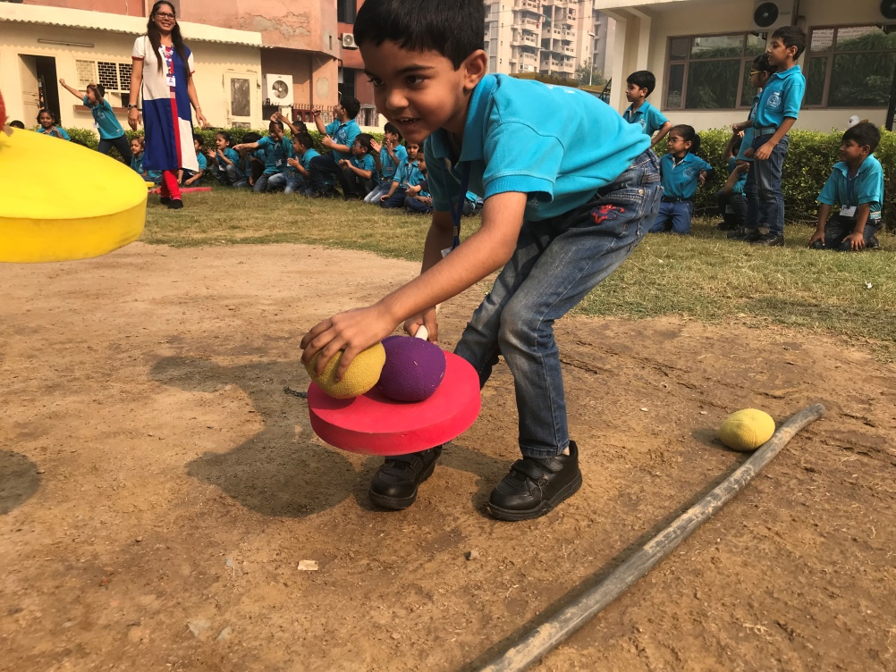
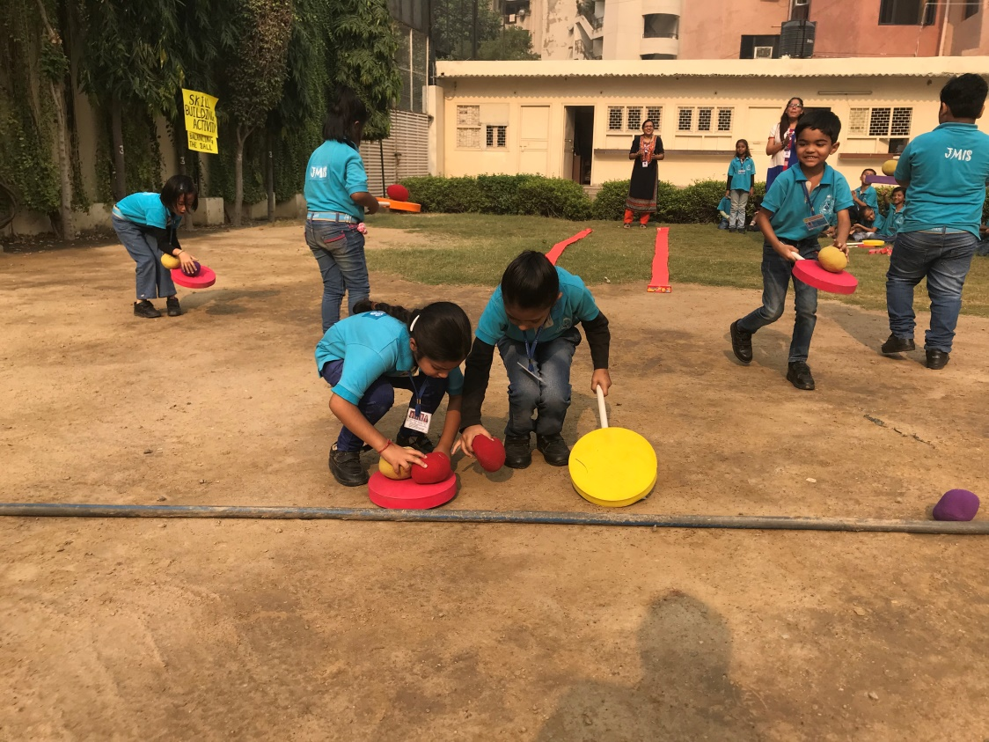
Learning colors, textures, balance and team work, all with play and joy…..

Slide 4
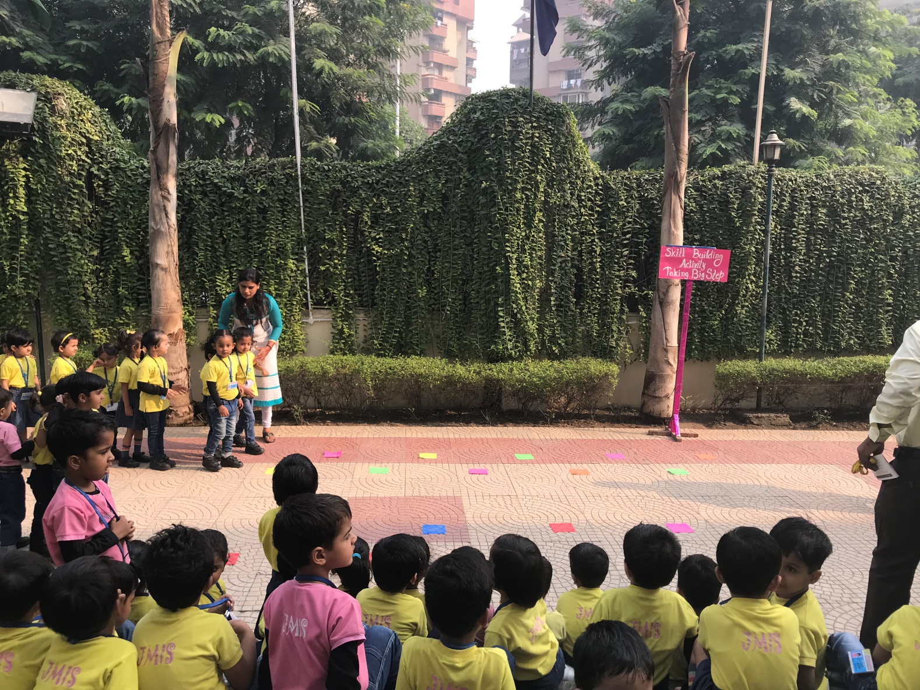
What a colourful display of kids trying to take big but balanced steps forwards, and naturally developing their skills…..!!!

Slide 5
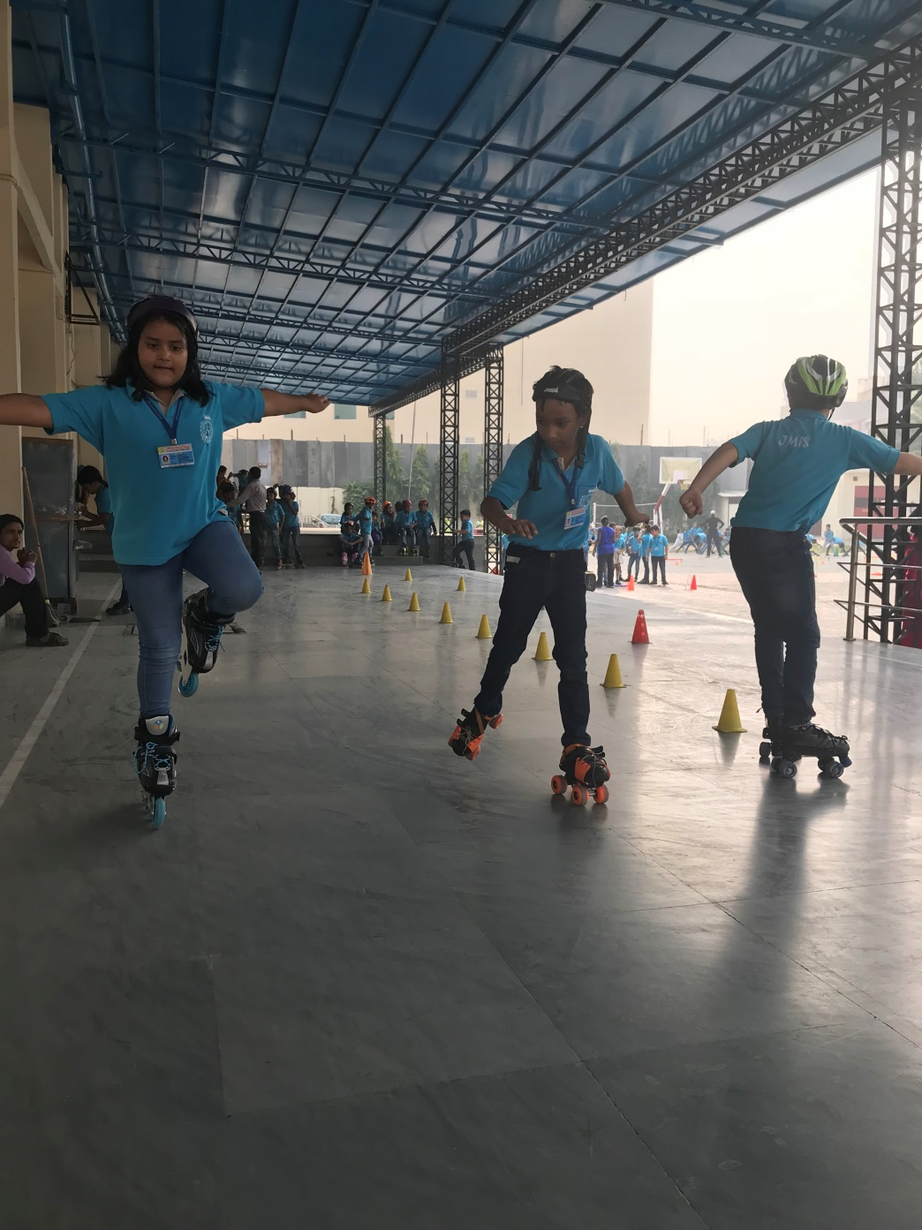
Wow…..how do you do that???

Slide 6
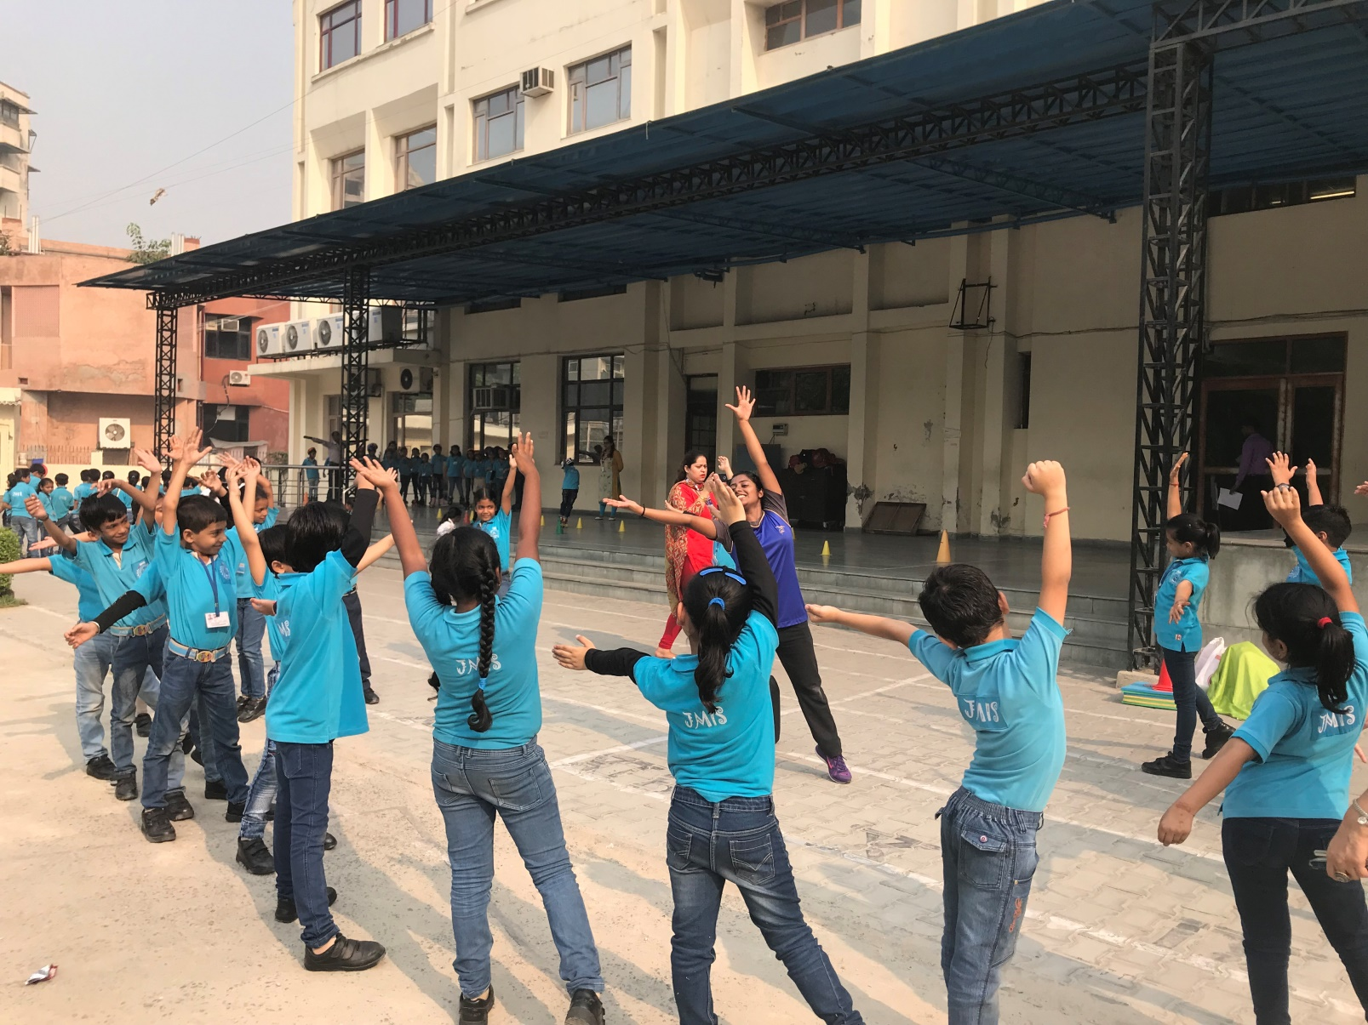
What a joyful learning of Daylight and shadow relation, with dance and play with shadows…..!!!

Slide 7
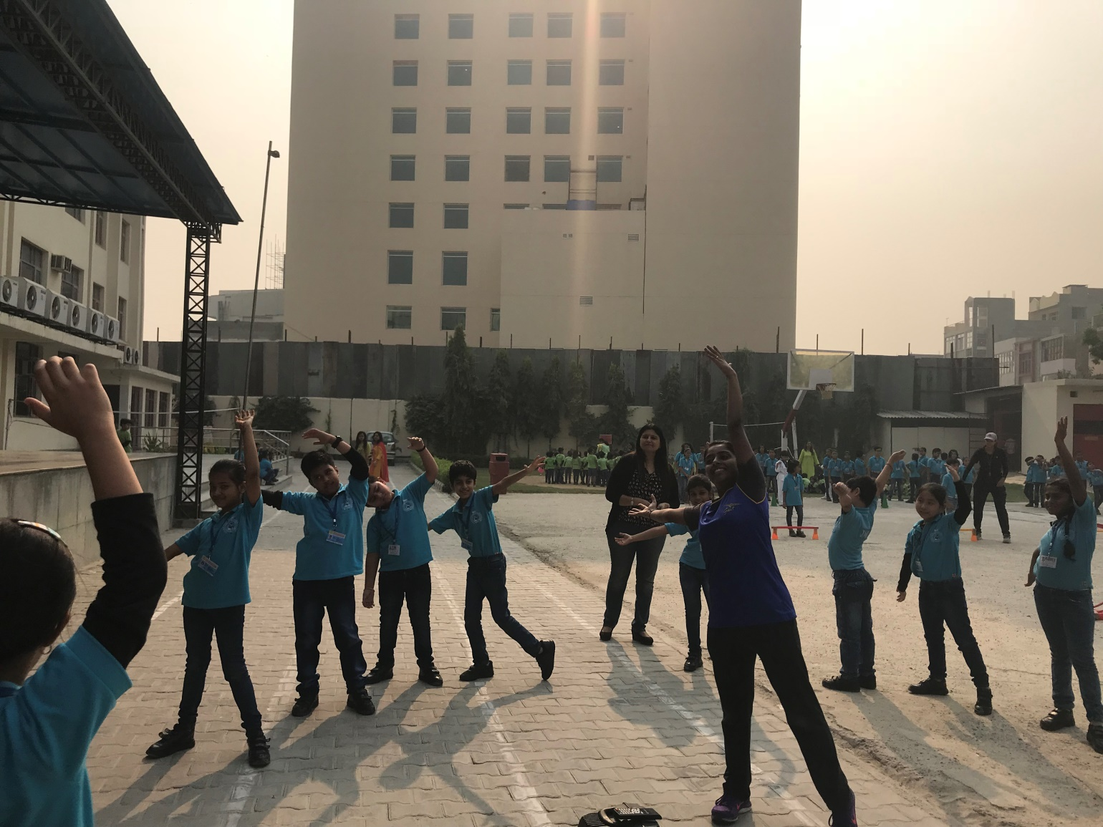
Rejoice and play with your shadows..!!! See how the sunlight and shadows play with you….!!! How amazingly the teachers dance with the kids to make them learn……!

